Slide 1

Interesting Apps and Websites related to RateIT

Slide 2
Interesting Apps
1

Slide 3
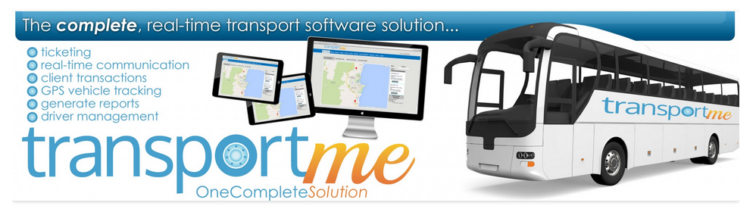
transportme
Screenshot
Patent pending.
Described as a ‘complete operational and management solution’
Intended to be useful worldwide

Slide 4
transportme
http://www.transportme.com.au
App developed by Ryans Bus Service Operations Manager.
In the future they hope to release a consumer version with a ‘direct link to the bus’.
http://www.transportme.com.au/wp-content/uploads/2014/07/ABC-media-article.jpg
transportme provides the following services:
Live GPS Tracking
An Integrated Ticketing System
Real-Time Reporting that is simple to access
Overspeed Logs
Passenger Boarding Point Information
Bus Stop Time Tagging through Geofences
Driver Sign On/Off
ATO Diesel Fuel Fill Information
Instant and Future Messaging to your Fleet
Driver Alert for Passenger Departure Points
http://www.transportme.com.au/wp-content/uploads/2014/07/transportme-A4-brochure-WEB.pdf

Slide 5
SaferBus
http://www.fmcsa.dot.gov/safety/passenger-safety/saferbus-mobile-application
The SaferBus mobile app provides the user with the following functions/options:
Confirmation that a bus company is allowed to operate,
Reviews of bus safety performance across a range of categories
These categories include: - unsafe driving, hours-of-service compliance, - driver fitness, - controlled substances and alcohol testing results, and – vehicle maintenance, and
Filing complaints (the app allows consumers, drivers and members of industry to file a complaint about safety, service or discrimination via a National Consumer Complaint Database.

Slide 6
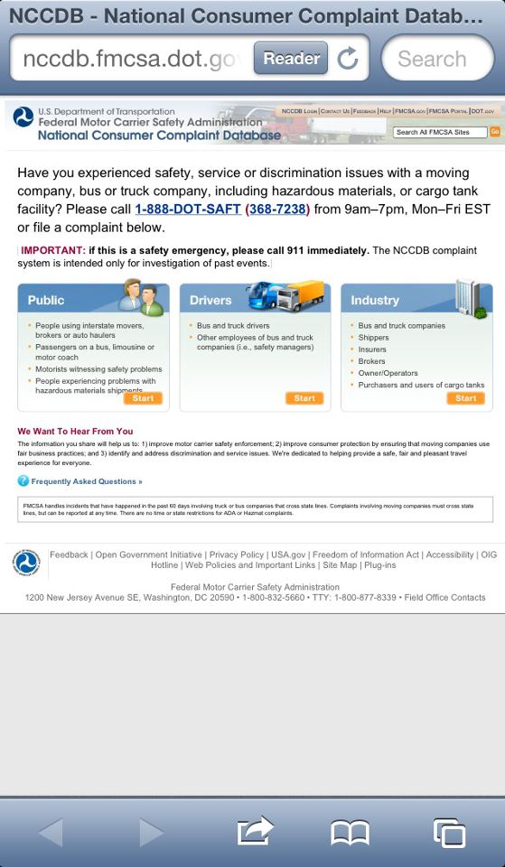
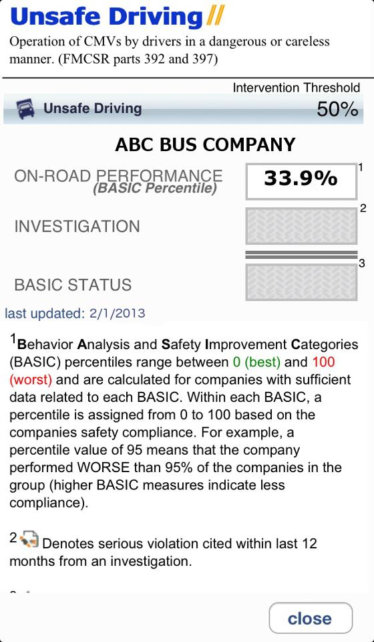
SaferBus

Slide 7
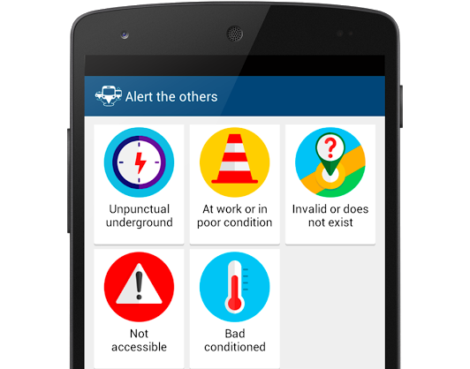
App & Town – Public Transport
https://play.google.com/store/apps/details?id=cat.uab.onthebus&hl=en
App that includes the following functions:
the nearest stop,
the expected time of arrival of the transport,
the faster and free of incidents route,
the schedules and routes of transportation on official maps,
the best choice when moving with baby carriage or wheelchair, among others.
Also contains ‘Alert others’ function that includes:
air-conditioning,
unpunctual services,
maintenance work, and
whether a service exists.

Slide 8
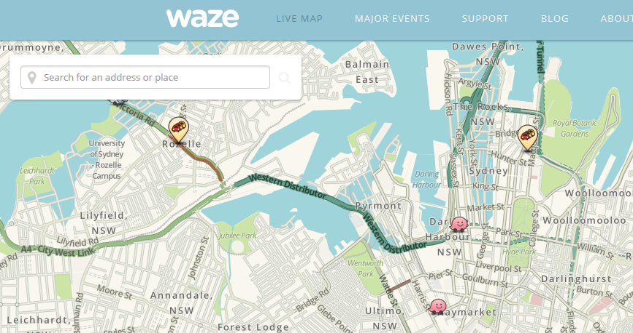
Waze
https://www.waze.com/
One of the world's largest community-based traffic and navigation apps. (Does not include public transport but it is a widely used app)
Allows drivers to share real-time traffic and road info.

Slide 9
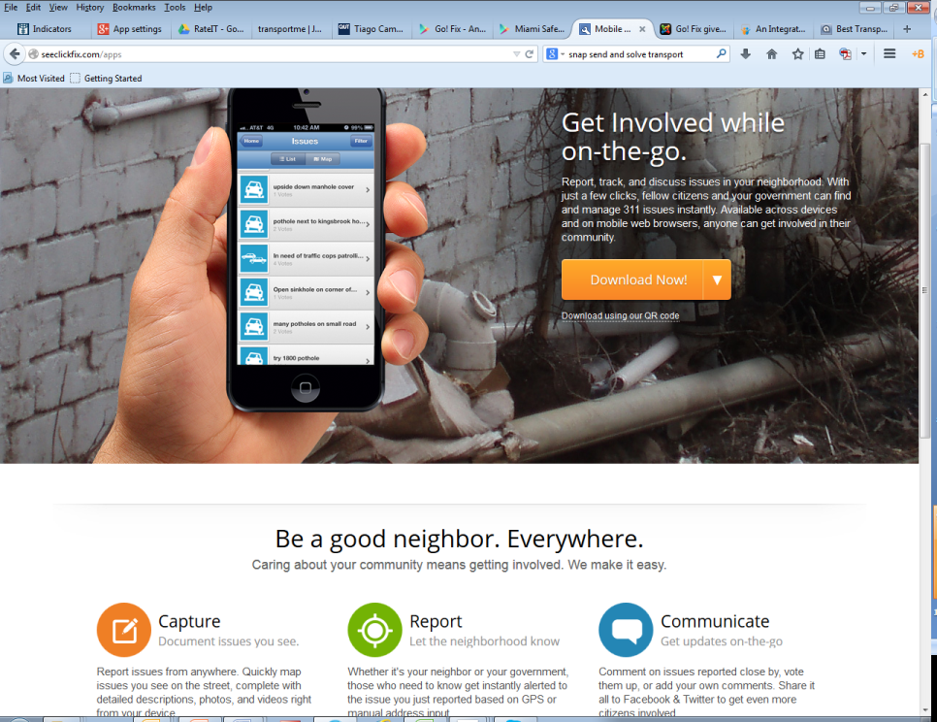
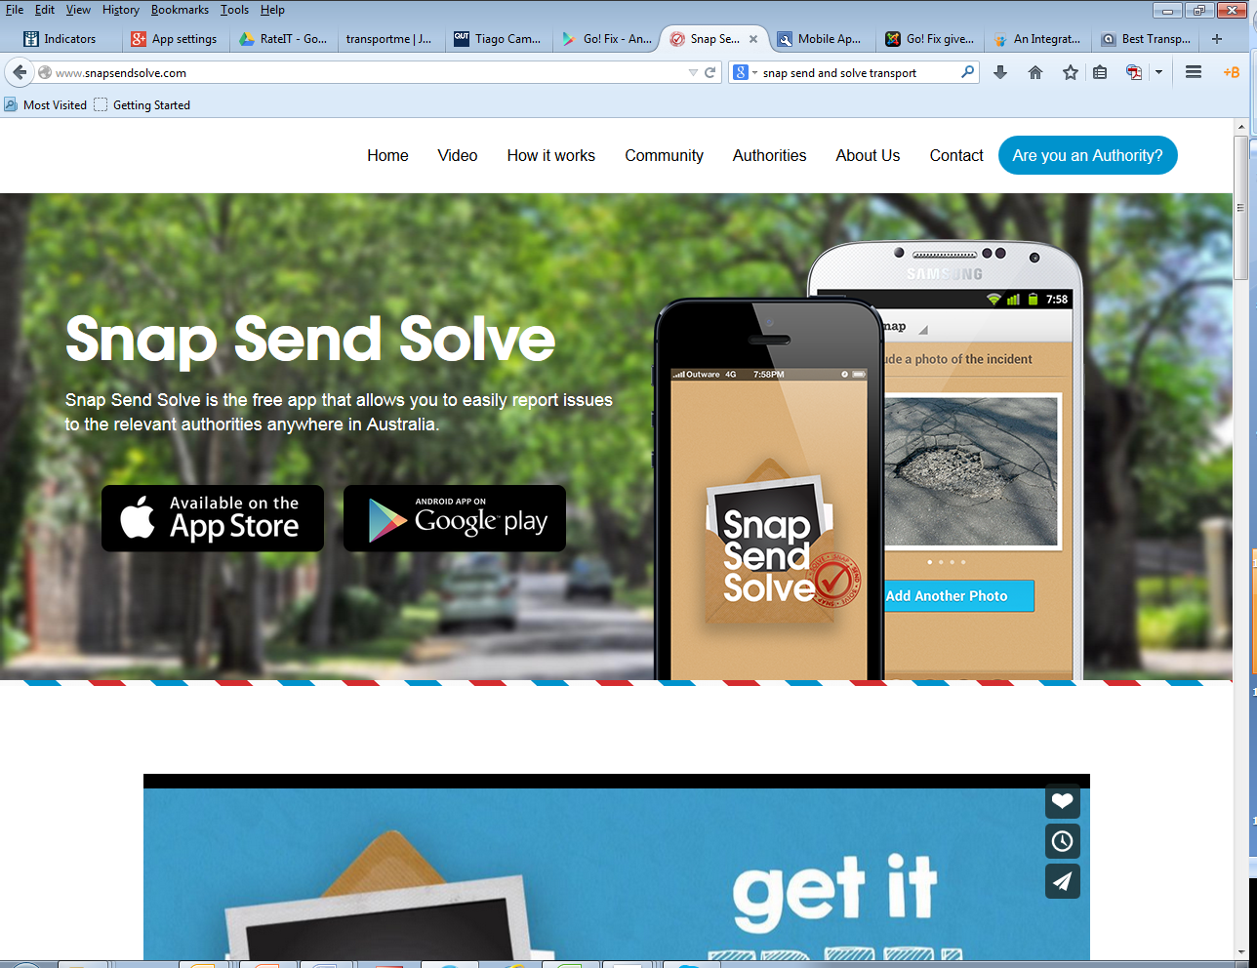
See Click Fix & Snap Send Solve
A family of apps developed by See Click Fix using 311 platform.
http://seeclickfix.com/apps
Snap Send Solve is an Australian version: http://www.snapsendsolve.com/

Slide 10
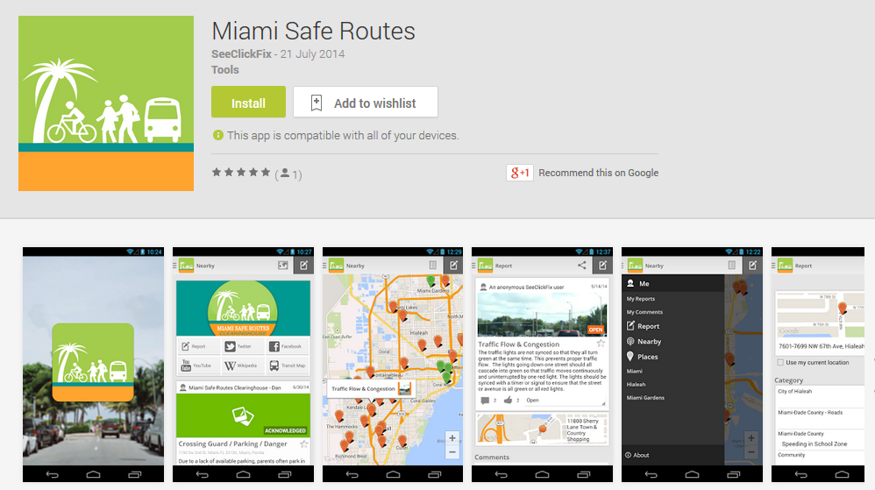
Miami Safe Routes
Developed by SeeClickFix but focused on safe routes to school
Screenshot from GooglePlay store

Slide 11
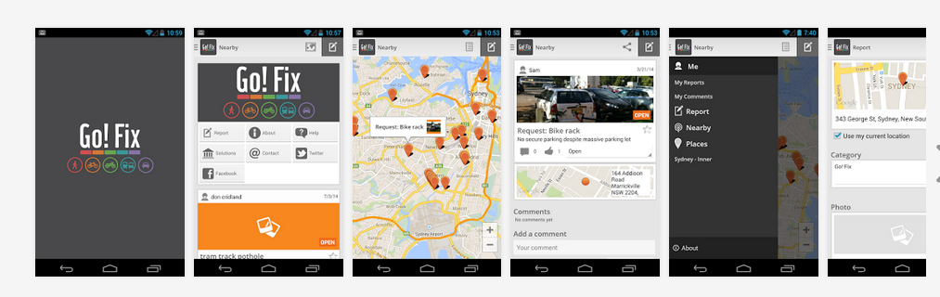
Go! Fix
Another app using the 311 platform by See Click Fix.
This one focused on all types of transport modes and the transport infrastructure in Australia.
Cyclists are a specific audience using it to get infrastructure improvements
Screenshot from GooglePlay store

Slide 12
Interesting Websites
2

Slide 13
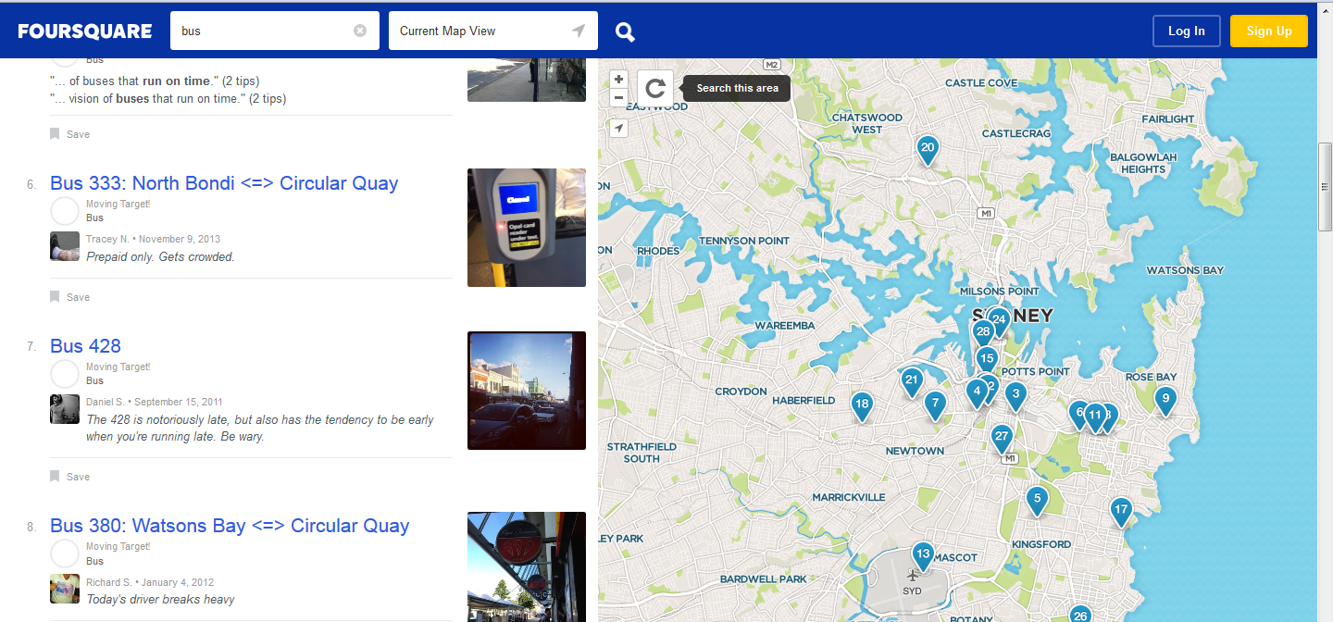
Foursquare
https://foursquare.com/explore?mode=url&near=Sydney%2C%20NSW&q=bus
Location based website with ratings and comments.
Currently has comments on bus stops and bus routes – including comments about lateness, crowded buses and a driver breaking heavy.

Slide 14
Interline Feedback
http://www.interlinebus.com.au/feedback.html
Online feedback form that has questions on:
Bus keeping to timetable,
Journey time,
Getting a seat on the bus,
Comfort of the seats,
Cleanliness of the bus,
Timetables posted at the bus stop,
Buses meeting other bus/train connections,
Helpful and friendly drivers,
A smooth bus ride,
Bus frequency,
Hours of operation,
Shelter at the bus stop,
Seat at the bus stop,
Prepaid tickets (MyZone),
Ticket and fare information,
Personal Security at the bus stop,
Personal Security on the bus,
Overall, how satisfied are you with your experiences on Interline bus services?

Slide 15
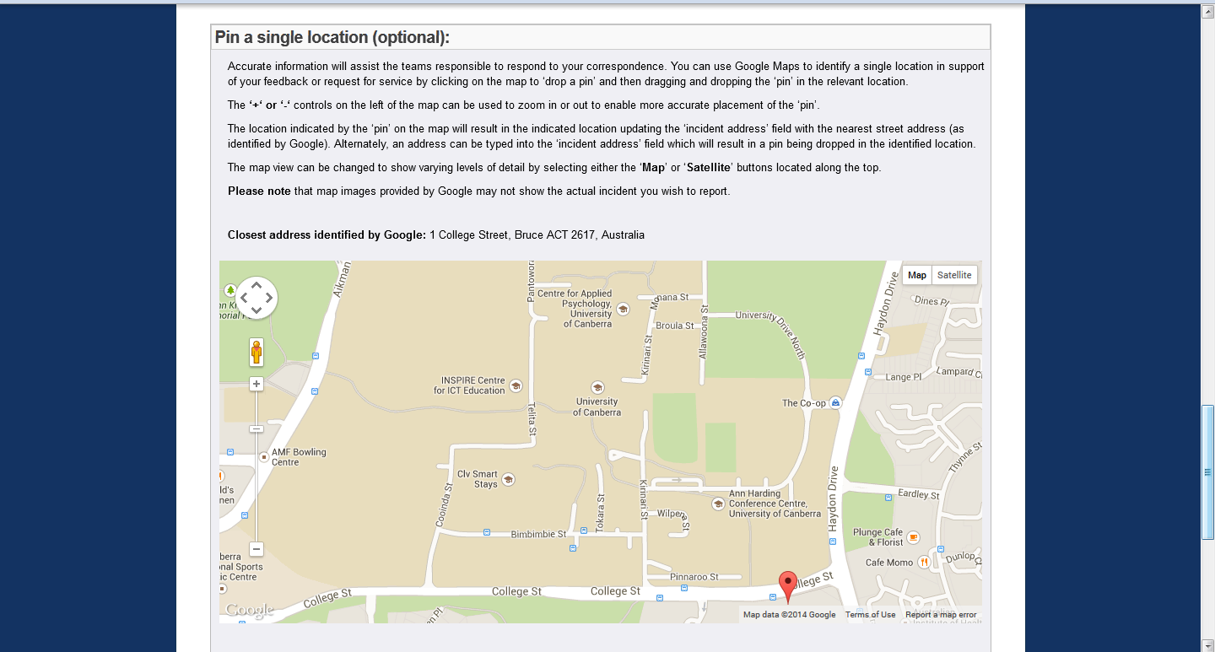
https://www.canberraconnect.act.gov.au/app/forms/action_feedback
Online feedback form that allows you to pin point your location when making a complaint/compliment.

